Slide 1

Presentation on Bangladesh Presented by Suriaya Akter Jhuma

Slide 2
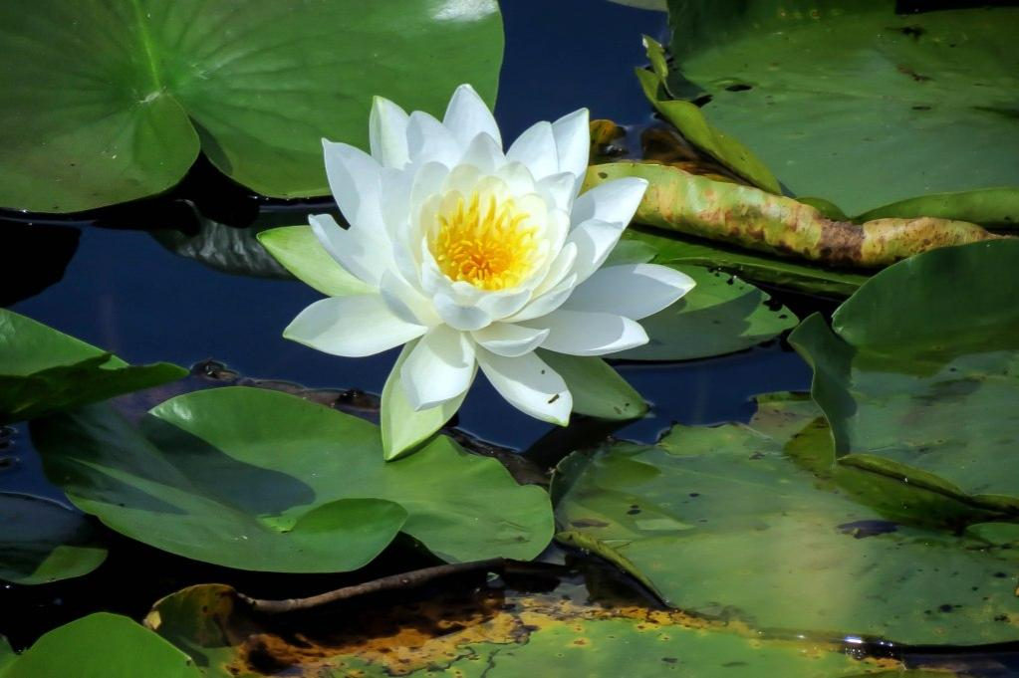
National Flower of Bangladesh
Water lilies are a well-studied family of plants because their large flowers with multiple unspecialized parts were initially considered to represent the floral pattern of the earliest flowering plants.

Slide 3
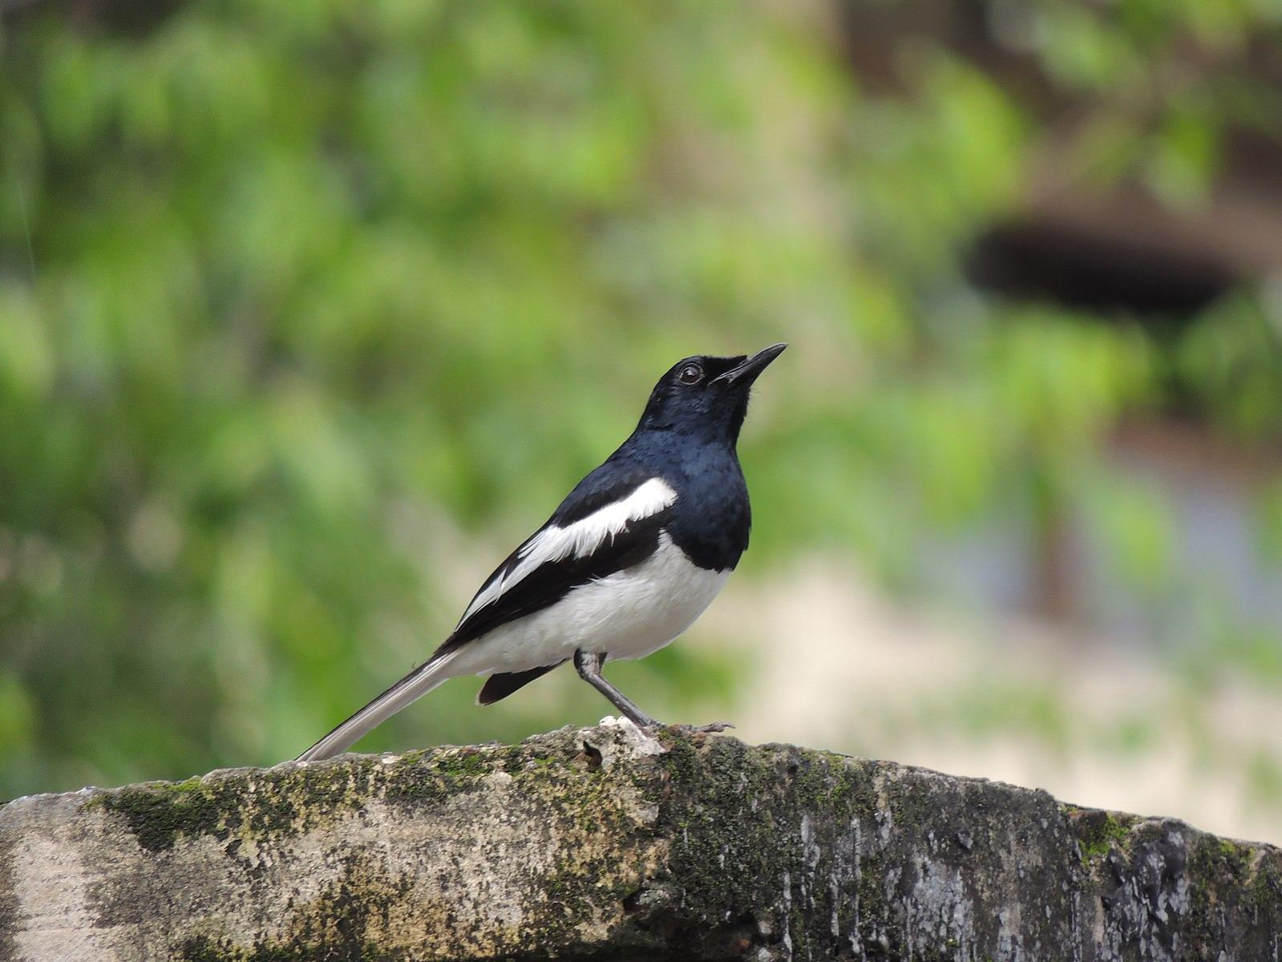
National Bird of Bangladesh
The oriental magpie is a common bird in Bangladesh and is often seen in towns and villages. It is also a symbol of Bangladesh and appears on the country’s . currency.

Slide 4
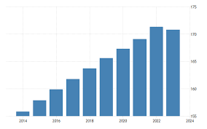
Population & River
Population of Bangladesh
Rivers of Bangladesh
Padma
Jamuna
Teesta
Meghna
Brahmaputra
Kushiyara
Shangu

Slide 5
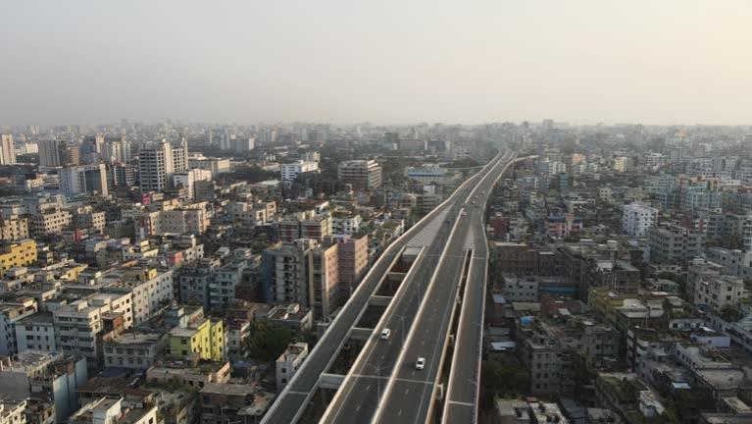
Capital Of Bangladesh
Dhaka formerly known as Dacca, is the capital and largest city of Bangladesh.

Slide 6
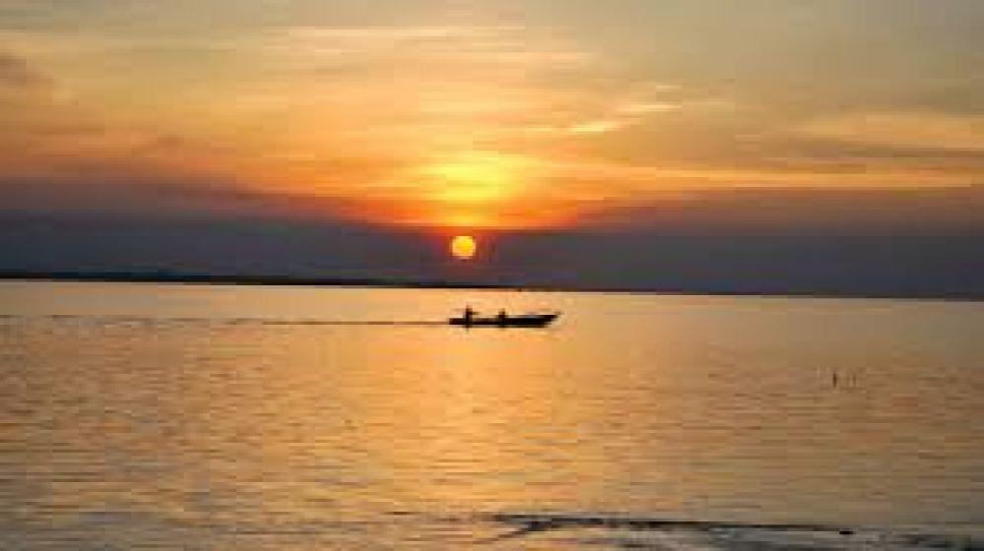
Padma River
The Padma River, a significant river in Bangladesh, is renowned for its dynamic course and scenic beauty. It's a main distributary of the mighty Ganges, known locally as the Ganga, which flows down from India and meets the Jamuna River in Bangladesh.

Slide 7
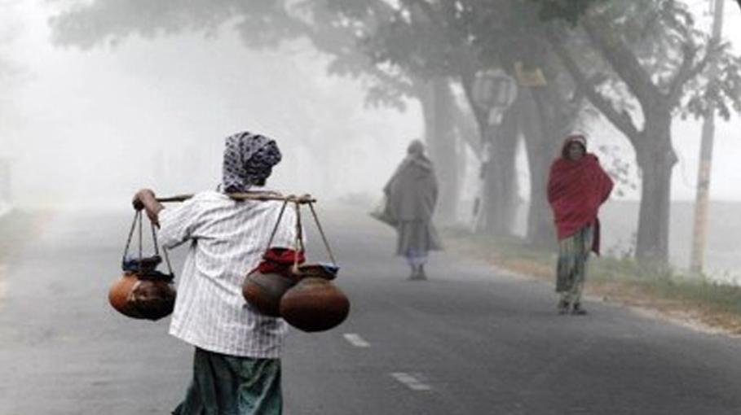
Winter Morning in Bangladesh
Winter is one of the six seasons of Bangladesh and it is the season of fog, mists, and chill. During the winter season cold air follows, sometimes temperature level usually decreasing up to 3°C to 4°C and a generally average temperature drops to 10°C to 20°C.

Slide 8
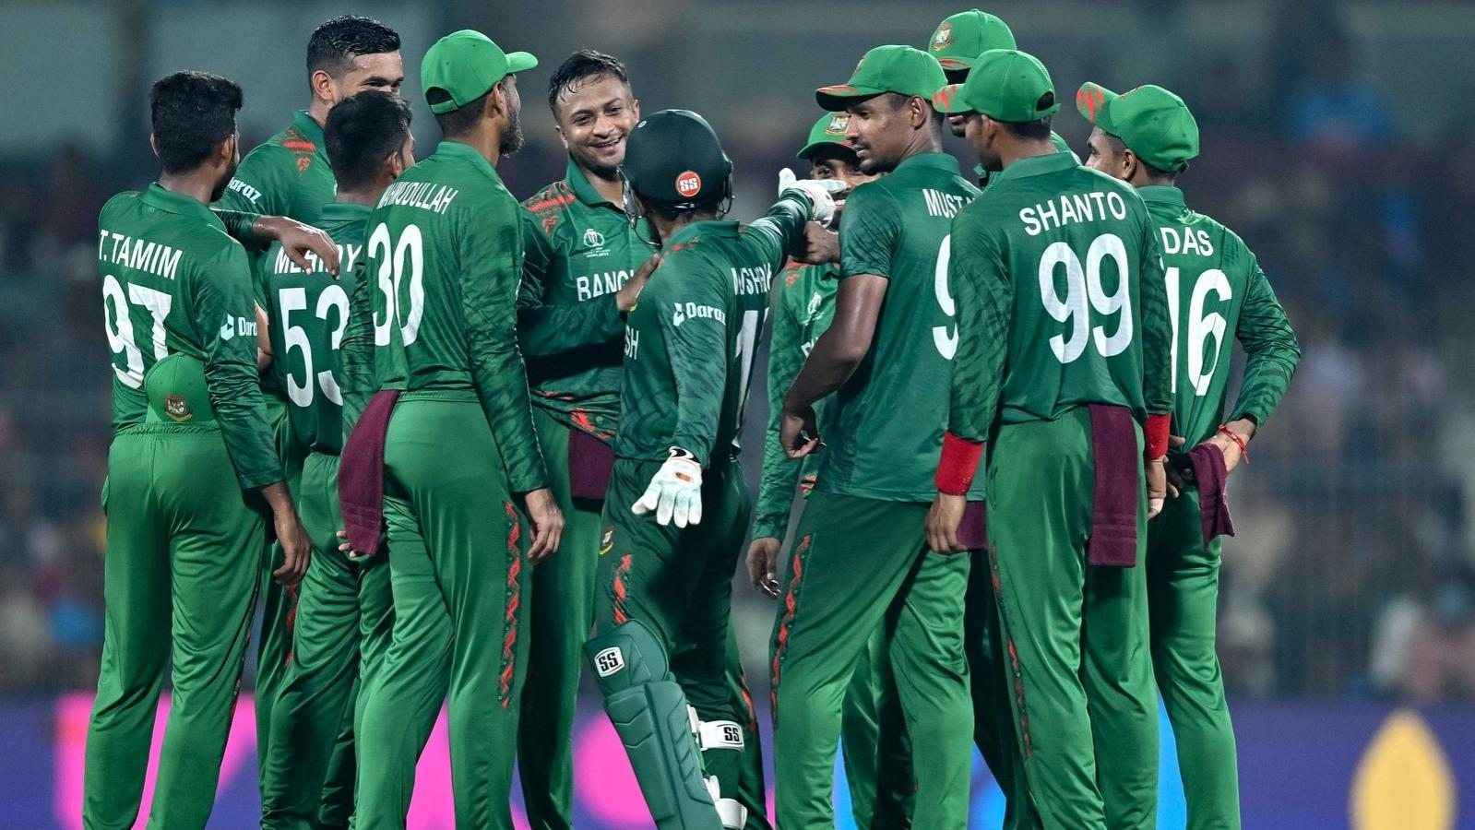
Bangladesh Cricket
For Bangladesh is cricket’s most tempestuous territory where emotion fuels the smallest of debates and decision-making swings wildly between reason and the absurd. When Bangladesh won the ICC Trophy in 1997 to qualify for the World Cup for the first time

Slide 9
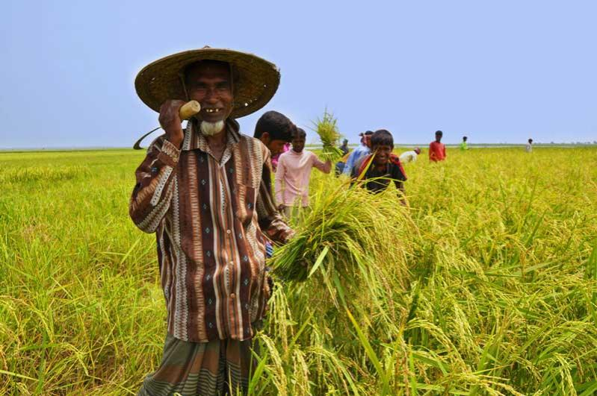
Agriculture Of Bangladesh
Bangladesh is primarily an agrarian economy. Agriculture is a large producing sector of economy since it comprises about 14.2% of the country's GDP and employing around 47% of the total labour force.

Slide 10


